Slide 1
Avaya Device Adapter Snap-in - CS 1000 Solution Migration (Modernization) - High Level Architecture
Miloš Pujić
Nov.27, 2017
v.15

Slide 2
Goals
Facilitate CS 1000 customer retention/conversion to Avaya Aura®

Slide 3
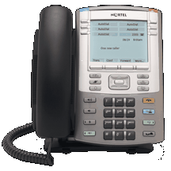
A “Typical” CS 1000 Customer Solution - Before
LEGEND
UCM – Unified Communication Manager
CS – Call Server
TPS – Terminal Proxy Server
PD – Personal Directory
ELAN – Management LAN
MG – Media Gateway
MGC – Media Gateway Controller
MG-EXPEC – Another type of Media Gateway Controller
Primary Data Center
Secondary (Geo-redundant) Data Center
System Management COTS Server
System Management COTS Server
Active
UCM
Standby
UCM
Active
Hot-Standby
CS1000 Call Server
CS1000 Call Server
CS1000 Call Server
CS1000 Call Server
Hot-Standby
CS
Active
CS
Active
CS
Hot-Standby
CS
ELAN /
PBX-Link
Signalling Server Cluster
1 Leader
Many Followers
CS 1000 MG #1
(aka CS 1000 Shelf with
Line Cards)
Signalling Server
CS 1000 MG#2
(aka CS 1000 Shelf with
Line Cards)
MGC / MG-XPEC
Signalling Server
MGC / MG-XPEC
TPS
PD
Signalling Server
TPS
PD
PD
TPS
TDM
UNISTIM
TDM

Slide 4
A “Typical” CS 1000 Customer Solution - After
In view of CM, an CS 1000 endpoint is an AST SIP endpoint (analogous to 96X1 SIP)
Primary Data Center
Secondary Data Center
Active
SMGR
Standby
SMGR
Legend:
Geo-Redundant
CM
Existing CS 1000 SW Modules
Existing Avaya SW Modules
SM
SIP over TLS
SM
New SW Module - ADA
Primary
Primary
Secondary
Primary Breeze Cluster
Secondary Breeze Cluster
ADA
ADA
Device
Adapter
Device Adapter
ADA
ADA
PBX-Link
over IPsec
PBX-Link over IPsec
CS 1000 MG #1
(aka CS 1000 Shelf with
Line Cards)
CS 1000 MG #2
(aka CS 1000 Shelf with
Line Cards)
MGC / MG-XPEC
MGC / MG-XPEC
TDM
UNISTIM over DTLS
TDM

Slide 5
Assumptions
CS1000 Call Server SW is removed from the solution – its functions are now assumed by the ADA snap-in and the Avaya Aura® core (CM, SM)
CS1000 Signalling Server SW components are removed from the solution – the related functions (Terminal Proxy Server – TPS and Personal Directory – PD) are fully assumed by the ADA snap-in
The device adaptation (from CS 1000 Stimulus to SIP AST) is implemented on the Avaya Breeze platform by the Avaya Device Adapter (ADA) Snap-in
Leverages the Breeze platform
Leverages the Native C++ Client SDK
Administration of CS 1000 endpoints is done in SMGR
As in case of other Avaya Aura® SIP endpoint:
an SM profile is required, as well as
a CM profile
In addition, CM supports new endpoint types for CS 1000 endpoints
MGCs in the solutions will likely require firmware upgrade prior to switching them to ADA - This must be done without requiring the CS1000 CS upgrade
The design team will determine whether to base the implementation on
Option 1: The new custom MGC firmware (requires upgrade of all MGCs) or
Option 2: The latest CS 1000 (7.6) MGC firmware (requires upgrade of non-current MGCs)

Slide 6
Signalling Security
ADA provides secure signalling in the following manner:
SIP & HTTP signalling (towards SM) is protected by TLS
UNISTIM signalling (towards UNISTIM endpoints) is protected by DTLS
TDM-set signalling (PBX-Link… - towards MGC) is protected by IPsec in the transport mode
Breeze platform provides support for TLS, but (as of Breeze 3.3) does not support DTLS and IPsec
ADA implementation has to provide support for IPsec and DTLS
In addition, customers may optionally deploy SBCs and VPN GW boxes to additionally streamline and control flow of signalling
Typical SBC implementation to expect is the Avaya SBC for Enterprise (ASBCE)
We should expect usage of many brands of VPN GWs, including Avaya ASR-2330 and VSU-10000
Enterprise Network
Management VLAN
Breeze DC
SMGR
Management
Network
GW
MGC
MGC
Breeze Cluster
IPsec
Breeze Server
ADA
Breeze Server
ADA
Breeze Server
ADA
IPsec[PBX-Link+]
Mgmt
IF
Sec. Mod. IF
DTLS[UNISTIM]
IPsec
TLS
DTLS
DTLS
PBX-Link+
SIP
HTTP v
UNISTIM
SM
Enterprise
Network
GW
TLS
TLS[SIP]

Slide 7
Avaya Aura® and ADA on Premises
SMGR
CM
CM Administration:
5001: SIP Line
5002: SIP Line
SM
Existing HW Component
TLS
SIP
Mgmt VLAN
New HW Component
SIP over TLS
Breeze Cluster
Customer Premises
ADA
TLS
IPsec
DTLS
TCP:
ACP
X11-SSD
UNISTIM over DTLS
PBX-Link over IPsec
CS 1000 MG
(aka CS 1000 Shelf with
Line Cards)
MGC / MG-XPEC
IPsec
TDM
Extension
5001
DTLS
TDM
UNISTIM
Extension
5002

Slide 8
Avaya Aura® in Cloud – ADA on Premises Same Breeze Software – Different Deployment
SMGR
SM
CM
CM Administration:
5001: SIP Line
5002: SIP Line
SIP
Cloud
VPN GW
ASBCE
Existing HW Component
TLS
New HW Component
SIP over TLS
Breeze Cluster
Customer Premises
ADA
Customer VPN GW
TLS
IPsec
DTLS
TCP:
ACP
X11-SSD
UNISTIM over DTLS
PBX-Link over IPsec
CS 1000 MG
(aka CS 1000 Shelf with
Line Cards)
MGC / MG-XPEC
IPsec
TDM
Extension
5001
UNISTIM
Extension
5002
DTLS
TDM
Avaya Aura® 7.1 Cloud VPN solution is reused here for management operations

Slide 9
Avaya Aura® and ADA in Cloud Same Breeze Software – Different Deployment
Breeze
Cluster
CM
CM Administration:
5001: SIP Line
5002: SIP Line
ADA
SIP over TLS
SMGR
TLS
SM
IPsec
DTLS
TLS
Cloud VPN GW
Existing HW Component
Customer VPN GW
Customer Premises
New HW Component
UNISTIM over DTLS
TCP:
ACP
X11-SSD
PBX-Link over IPsec
CS 1000 MG
(aka CS 1000 Shelf with
Line Cards)
MGC / MG-XPEC
IPsec
TDM
Extension
5001
TDM
UNISTIM
Extension
5002
DTLS
Avaya Aura® 7.1 Cloud VPN solution is reused here for PBX-Link and UNISTIM signalling

Slide 10
Breeze Dependencies
ADA is based on Avaya Breeze™ 3.5 or newer

Slide 11
CM Dependencies
ADA depends on some CM enhancements slated for Avaya Aura® 8.0
CS1000-style MADN Support on CM
Includes both, Single Call Arrangement (SCA) and Multiple Call Arrangement (MCA)
Supports but does not require new behaviors on the AST SIP endpoints
An AST SIP endpoint handles both scenarios as the regular CM-style bridging (the bridged-appearance button)
CM Station Administration Changes in support of CS 1000 endpoints
New station types for CS 1000 endpoints
All CS 1000 station types are consider to be SIP stations
New station fields/attributes for CS 1000 station types:
CS 1000 Station Type (~ dozen types)
CS 1000 Terminal Number in terms of : Loop / Shelf / Card / Unit
Max number of buttons per add-on module page
Endpoint Features (CLS)
New button types for CS 1000 station types:
Conference button
Transfer button
CM Call Processing Changes in support of CS 1000 endpoints
Conference button handling
Transfer button handling

Slide 12
SM Dependencies
No SM dependencies have been identified so far
Here is a list of important existing SM “features” that ADA depends on and must fit into
SM Forgoing SIP Endpoint Authentication
SM does not challenge SIP requests coming from a trusted SIP entity accessing SM via end-end TLS
ADA is such an endpoint
SM Location-based Routing based on the “signalling location”
ADA indicates the “signalling location” of the caller by the IP address in the “bottom-most Via-header of the INVITE request” (locations must be administered using IP address patterns)
SM CAC (Bandwidth Management)
ADA indicates the “media location” of the caller by the IP address in the SDP (locations must be administered using IP address patterns)
PPM Dependencies
Handling of “conference” & “transfer” buttons
PPM maps these buttons into a “call-appearance” button with the appropriate lable

Slide 13
ADA Implementation
ADA implements AST SIP endpoint emulation for every CS 1000 endpoint it serves (UNISTIM and TDM endpoints)
Supported CS 1000 endpoints are ‘thin’ aka ‘stimulus’ endpoints
The stimuli include:
Endpoint → Controller direction: Hook status, Keypad presses, Key/button presses, Endpoint registration (IP endpoints) …
Controller → Endpoint direction: Ringer control, Key/button-lamp control, Display control, Media commands (IP endpoints) …
ADA and endpoints exchange the stimuli over the ‘PBX link’
IP endpoints: ‘PBX Link’ is established between ADA and a TPS
TDM endpoints: ‘PBX Link’ is established between ADA and a TPS
ADA exchanges AST SIP signaling with SM/CM
An ADA instance serves a group of CS 1000 endpoints
An ADA instance emulates a bunch of AST SIP endpoints – one for each ‘real’ CS 1000 endpoint
An ADA instance handles stimuli for a number of ‘real’ CS 1000 endpoints
For each CS 1000 endpoint, ADA runs an ‘endpoint state-machine’ logic that is driven by SIP interactions with SM/CM one side and stimulus interactions with real endpoints on the other side
The idea here is to use a Client SDK as the basis for the AST SIP endpoint emulation

Slide 14
ADA Implementation
Use the Native C++ CSDK in Multi-user Mode
Main functionality is implemented outside WAS (as a number of Linux processes)
We still need an ADA snapin
The ADA snapin instantiates the master Linux process that acts as a group controller / proxy for a number of CS 1000 endpoints
The ADA snapin provides access to the Avaya Aura® System Management data
The ADA snapin instantiates the Group Controller / Endpoint Proxy and provides configuration for every dependent CS 1000 endpoint
A SIP endpoint emulation is supported by a single native C++ CSDK instance for all CS 1000 endpoints (multi-user mode of the CSDK)
Each endpoint emulation gets a configuration file at instantiation time and has to be ready to receive configuration updates during run time (no PPM usage)
The group controller acts as proxy for accessing endpoints’ media engines and I/O operations (via PBX Link)
SM
Supports rich telephony!
SMGR
One TLS socket per endpoint! Scalability?
SIP
Breeze Server
C++ CSDK
[Linux Process]
Endpoint Emulator #1
[Object]
Endpoint Emulator #n
[Object]
…
Needs to support several thousands of endpoints!
Need proof of concept
Group Controller / Endpoint Proxy
[Linux Process]
Instantiates
Provides Config
ADA Snap-in
[WAS]
UNISTIM
PBX-Link
MGC

Slide 15
ADA Implementation – TPS & PD Elimination
Leaving the TPS in the customer solutions going forward has significant repercussions from both, customer perspective and R&D delivery effort perspective:
Customer aspect
Extra servers in the solution
Increased power consumption
Extra IP address assignment
Extra security considerations
Patching of the TPS software
…
R&D Delivery aspect
“Bringing up” the TPS in the environment without CS 1000 CS
IPSec support (IPSec not supported by Breeze, ADA take full ownership)
JITC accreditation with IPSec has significantly increased scope
…
The above has driven the decision to eliminate the original TPS from the solution

Slide 16
ADA Implementation
Native C++ CSDK in Multi-user Mode with “Internal” TPS
SMGR
SM
Breeze Server
SIP
ADA Linux process(es)
C++ CSDK
[Linux Process]
Endpoint Emulator #1
[Object]
Endpoint Emulator #n
[Object]
CS 1000 Endpoint App.
WAP
VTM
VTI LIB
ADA Snap-in
[WAS]
USI LIB
UNISTIM
X
TDM - UNISTIM Adaptation
CSV
ELC
RUDP
Reverse DSET
USI LIB
USI LIB
SSD LIB
RUDP
RUDP
UNISTIM
PBX LIB Server
Instantiates
Provides Config
HTTPS
PBX-Link
Card LAN
PD (optional)
MGC

Slide 17
ADA integration with the SM Origination-based Routing
How to extend SM differentiated routing to the non-SIP devices situated in different physical locations (i.e., allow non-SIP devices behind the Avaya Device Adapter (ADA) enjoy the current location-based routing)?
ADA adhering to the following would achieve the purpose without any SM changes:
When registering on behalf of a non-SIP endpoint, the ADA includes an extra Via header containing an IP address that belongs to the IP address map of the device’s location. The Contact header will continue to point to ADA’s address.
When initiating a call on behalf of a non-SIP endpoint, the ADA includes an extra Via header containing an IP address that belongs to the IP address map of the device’s location. The Contact header will continue to point to ADA’s address.
When processing the Register and Invite responses, which follow the Via header contents, ADA consumes the message (and not try to forward the message to the next hop).
Rather than establishing the location using the Contact header (which will incorrectly make each endpoint appear to be at the same location as that of the ADA), SM will establish the location of the endpoint using the bottom most Via header. This approach is similar to the bottom-most Via header based location determination (hence routing) provided to the non-SIP CM endpoints. With the original bottom-most Via header approach, CM doesn’t register with SM; whereas, with the ADA approach, ADA will register on behalf of the non-SIP endpoint.

Slide 18
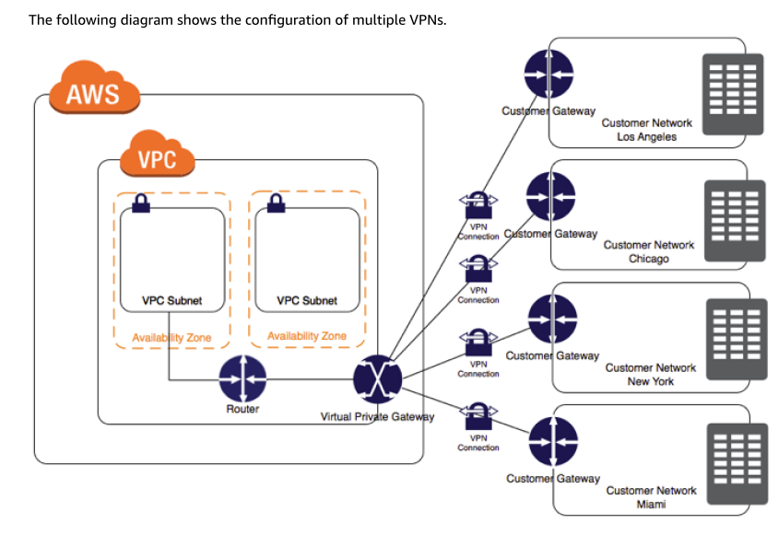
Avaya Aura® in AWS – VPN Solution
Aura in AWS is using an on premises VPN Gateway (aka VPN Service Unit - VSU) to connect to the Virtual Private Gateway of the AWS Virtual Private Cloud (VPC)
AWS Virtual Private Gateway and on premises VPN Gateway need to be administered for IPSec in a compatible fashion
Once the routing and firewalls are setup the gateways can connect via a secure connection
Most IPSec VPN Gateway implementations should be able to connect to the AWS VPC Virtual Private Gateway
Was Avaya Secure Router ASR-2330 tested?
Was Avaya VPN Service Unit VSU-xxxx tested?
An alternative to using AWS VPC Virtual Private Gateway is to deploy a softVPN in AWS
A reference VPN connectivity to AWS VPC:

Slide 19
Internal TPS Implementation Notes
Leader election implementation can be eliminated – use Breeze “Cluster IP” as the “Node IP”
The Breeze server that “hosts” the “Cluster IP” is the Leader; other servers from the cluster are the Followers
ADA needs an API to get the “Cluster IP”
ADA needs an eventing API to know whether the server is the “owner” of the “Cluster IP” – to be verified whether such an API exist
UNISTIM endpoint Load balancing (CSV) needs to be implemented
CSV runs on the Leader
The Followers need to share the information with the Leader about their current load (in terms of the number of UNISTIM clients they support at any point in time)
The existing broadcasting-based TPS status sharing can be eliminated
Instead, use data-grid to share the information
TPS ELC service can be eliminated
There is no value that ELC adds
CSV should redirect an UNISTIM endpoint directly to the working TPS
TPS communicates with the external PD over HTTPs
This is in support for the Directory, Caller and Redial lists on UNISTIM endpoints
HTTP requests are originated by TPS i.e. TPS acts as an HTTP client and PD as the HTTP server

Slide 20
MGC Support Notes
Use a VPN GW to secure MGC ←→ ADA communication
MGC ←→ ADA Communication includes:
PBX-Link (TCP port 15000 on ADA)
Card/Unit related signalling (TCP port 32781)
RPC connection (TCP port32788)
Heartbeat (UDP port 32779 on ADA)
Any other?
Notes:
On MGC, card LAN and SSD phone messages are carried in SSD TCP connection on port 32781.
There must be a heartbeat UDP connection on port 32779.
MGC also performs a registration request to call server via RPC on port 32788 during startup.
These are mandatory connections.

Slide 21
MGC Support Notes…continued
Digital Line Card / Digital Set Status
Status of a digital set will drive SIP registrations/unregistrations
When MGC starts up it resets all IPE cards. This is the same when card is inserted.
Once DLC card is detected, a CLAN XMI002 message is sent to CS. Also, all unit memory blocks on that card is marked for audit.
There’s a special polling audit running on MGC to poll all slots on DLC card if it’s enabled.
Audit picks up those blocks and starts polling a31 chip.
If there’s a phone connected, the phone (or fpga) responds.
Audit gets the response and sends SSD message 0x0709 – unit is equipped – towards call server.
Call server handles it and starts regular phone initialization.
Audit keeps polling all slots including the phone that just found.
The phone gets unplugged.
Audit receives no responses in say 0.5 sec, declares it as not equipped and sends SSD 0x070A towards CS. CS marks unit as not present.
When card is ejected, clan sends XMI001. Have not checked if units on CS are put to disabled state upon xmi001 or set-not-found SSD… but should be either reason.

Slide 22
Background Information: CS 1000 Protocol Stack
Choice of integration points (not limited to):
Call Processing
Application
Port: 15000
Integration Point #3
TCP:
RAS
ACP
X11-SSD
PD
TCP:
ACP
X11-SSD
TPS
PBX LIB
WAP
SSD LIB
DSET
Integration Point #2
VTM
CSV
ELC
VTI LIB
USI LIB
USI LIB
USI LIB
Integration Point #1
RUDP
RUDP
RUDP
Port: 4100
Port: 5100
Port: 7300
TDM
Extension
5002
2
UDP:
- UNISTIM
3
MGC
1
CS 1000 MG
UNISTIM
Extension
5001
How much of the TPS should we keep in the ADA architecture?
Whole TPS?
Just bottom 2 layers?

Slide 23
CS 1000 Expansion Modules
11xx Series
GEM (Graphic Expansion Module)
Has 18 keys
Not all models support the GEM e.g. 1110 does not, but 1120E/1140E/1150E/1165E do
Up to 3 GEMs per set
Note:
The sets and GEM are still supported
Only 1120E and 1140E are still in production (and we just did the LTB for their CPU)
i20xx
i2002 & i2004 support 24-key LCD KEM
With Shift provides 48 keys
Up to 2 KEMs per set
12xx Series
Has two KEMs models: 18-key LED KEM and 12-key LCD KEM
Not supported on 1210, but supported on 1220 and 1230 (I believe this is a CS1k marketing limitation)
Up to 3 LED KEMs per set (? - BCM only support up to 2 so CS1k may have the same limitation)
Up to 7 LCD KEMs per set
Note:
The sets and KEMs are still supported
All three set models are still in production (but we have already did the LTB for their CPU a while back)
LED KEM has not been production for many years
M39xx Series
Has two expansion modules: 22-key KBA (Key Based Accessory) and 8-key DBA (Display Based Accessory)
Up to 2 KBAs and 3 DBAs per set are supported on the M3904 and M3905(ph3)
Note:
The sets and KBA are still supported
DBA was EoS in 2012
The last product in the M3900 family that is still in production is the 3904 and that will end this year (as soon as next quarter)
Aries
22-key AOM
Up to 2 AOMs per set

Slide 24
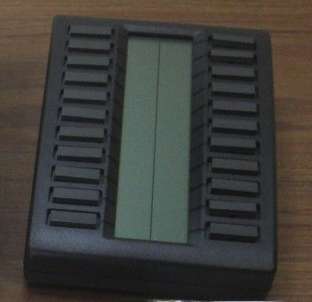
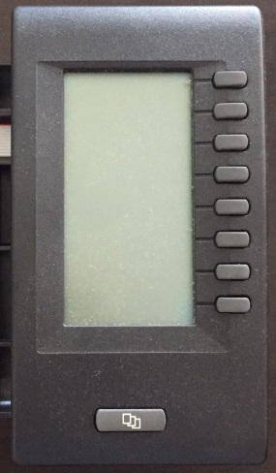
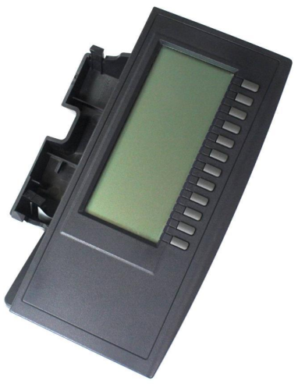
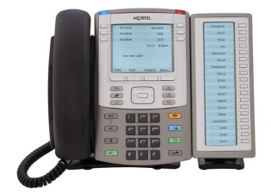
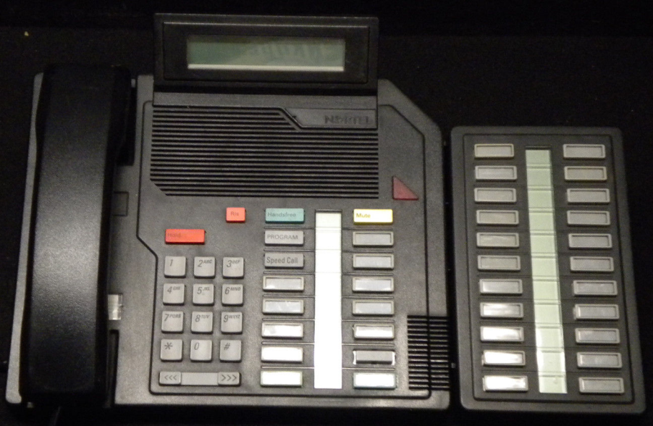
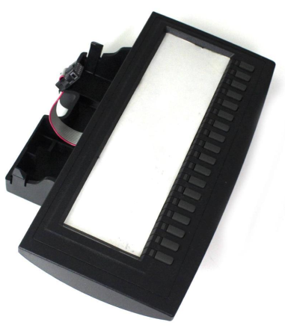
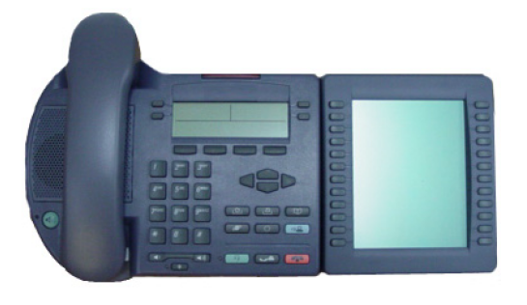
CS 1000 Expansion Modules
39xx 22-key KBA
39xx 8-key DBA
12xx 12-key LCD KEM (KEM4)
11xx with 18-key GEM (KEM3)
Aries with 22-key AOM
12xx 18-key LED KEM (KEM3)
i20xx with 24-key LCD KEM
(2xKEM4)

Slide 25
Add-on Module Support by ADA
Several add-on module types are supported on CS1000
11XX endpoints (IP) GEM (Graphic Expansion Module)
18 physical keys (possibility of 2 pages with SHIFT); max 3 modules
12XX series endpoints (IP) 12-key LCD KEM
12 physical keys (possibility of 2 pages with SHIFT); max 3 modules
12XX series endpoints (IP) 18-key LED KEM
18 physical keys; max 2 modules; paper labels
20xx series endpoints (IP) 24-key LCD KEM
24 physical keys; max 2 modules
Aries (2216|2616) endpoints (Digital) 22-key AOM (Add-On Module)
22 physical keys; max 2 modules; paper labels
39xx series endpoints (Digital) 22-key KBA (Key Based Accessory)
22 physical keys; max 2 modules
39xx series endpoints (Digital) 8-key DBA (Display Based Accessory)
8 physical keys; max 2 modules
CM Endpoint Administration – New Attributes for CS1000 endpoints behind CA
CS1000 Endpoint Type
Number of Add-on Module Pages – “Button Module Pages”
Number of Keys/Buttons per Page – “Buttons per Page”

Slide 26
Add-on Module Support by ADA…
Add-on Module | CS1000 |  | CM |  | Notes
18-Key GEM for 11xx Series Endpoints | TYPE=1140 CLS KEM3 |  | CS1000-Type=1140 Buttons-per-Page=18 |  | Starting Key Number on 1st module: 32
 | KEM | 1 | Button-Module-Pages | 2 (because of the SHIFT) | Total Keys: 68 (32+2x18)
 | KEM | 2 | Button-Module-Pages | 2 | Total Keys: 68 (32+2x18)
 | KEM | 3 | Button-Module-Pages | 3 | Total Keys: 86 (32+3x18)
12-Key LCD KEM for 12xx Series Endpoints | TYPE=1230 CLS KEM4 |  | CS1000-Type=1230 Buttons-per-Page=12 |  | Starting Key Number on 1st module: 32
 | KEM | 1 | Button-Module-Pages | 2 (because of the SHIFT) | Total Keys: 56 (32+2x12)
 | KEM | 2 | Button-Module-Pages | 3 (because of the 2x SHIFT) - 4th page not supported | Total Keys: 68 (32+3x12)
 | KEM | 3 | Button-Module-Pages | 3 | Total Keys: 68 (32+3x12)
 | KEM | 4 | Button-Module-Pages | - not supported | ---
18-Key LED KEM for 12xx Series Endpoints | TYPE=1230 CLS KEM3 |  | CS1000-Type=1230 Buttons-per-Page=18 |  | Paper labels. Starting Key Number on 1st module: 32
 | KEM | 1 | Button-Module-Pages | 1 | Total Keys: 50 (32+18)
 | KEM | 2 | Button-Module-Pages | 2 | Total Keys: 68 (32+2x18)
24-Key LCD KEM for 20xx Series Endpoints | TYPE=2004 CLS KEM4 |  | CS1000-Type=2004 Buttons-per-Page=24 |  | Starting Key Number on 1st module: 32
 | KEM | 1 | Button-Module-Pages | 1 | Total Keys: 56 (32+1x24)
 | KEM | 2 | Button-Module-Pages | 2 | Total Keys: 80 (32+2x24)

Slide 27
Add-on Module Support by ADA…
Add-on Module | CS1000 |  | CM |  | Notes
22-Key AOM for Aries Endpoints | TYPE=2216|2616 CLS AOM |  | CS1000-Type=2216|2616 Buttons-per-Page=22 |  | Paper labels. Starting Key Number on 1st module: 16
 | KEM | 1 | Button-Module-Pages | 1 | Total Keys: 38 (16+22)
 | KEM | 2 | Button-Module-Pages | 2 | Total Keys: 60 (16+2x22)
22-Key KBA for 39xx Endpoints | TYPE=3904|3905 CLS KBA |  | CS1000-Type=3904|3905 Buttons-per-Page=22 |  | Starting Key Number on 1st module: 32
 | KEM | 1 | Button-Module-Pages | 1 | Total Keys: 54 (32+22)
 | KEM | 2 | Button-Module-Pages | 2 | Total Keys: 76 (32+2x22)
8-Key DBA for 39xx Endpoints | TYPE=3904|3905 CLS DBA |  | CS1000-Type=3904|3905 Buttons-per-Page=8 |  | Starting Key Number on 1st module: 32
 | KEM | 1 | Button-Module-Pages | 1 | Total Keys: 40 (32+8)
 | KEM | 2 | Button-Module-Pages | 2 | Total Keys: 48 (32+2x8)

Slide 28
CM Expansion Modules
CM supports up to 3 button modules
CM numbers buttons based on certain “sections”:
Those on the main phone are considered part of the Feature Module.
Those in Button Modules are all collectively considered part of the Coverage Module.
Thus, for a phone with 96 buttons, the buttons are numbered Feature Module (Section 1) 1-24 and Coverage Module (Section 2) 1-72.
The numbering that PPM uses when sending buttons to the phone is simpler:
When PPM sends the button data to the phone, the button index is from 1-96 (verified by traceSM).
There is no module concept at all when PPM download the data to the phone.

Slide 29
CM Expansion Modules …
Endpoint button definitions are stored in 3 SMGR tables
‘ipt_button’ table
‘ipt_feature_button’ table
‘ipt_expmodule_button’ table
‘label’ column represents the button number

